Slide 1
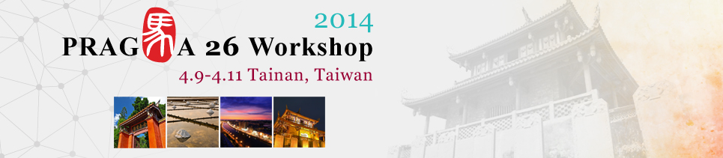
Cyber-Learning Activities in Taiwan --- EM Education
Hsi-Ching Lin
NCHC

Slide 2
Agenda
Motivation
Mission
Organization
The Role of the Platform by NCHC
Conclusion & Future Work
Q&A

Slide 3

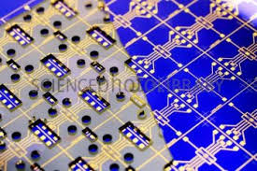
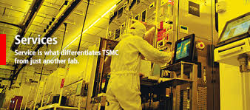
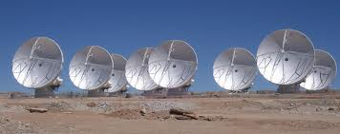
Motivations
Importance of EM field theory
- From ELF to visible light
- From nano devices to ALMA.
- From communication to forecasting

Slide 4
Motivations
Challenges in EM educations
- The very first course in EE that simultaneously requires
Mathematical skills with vector calculus
Physical understanding of wave propagation
- Long history, but we have a very limited time.
- Challenges from the emergent new fields in EE.
- Tendency of downplaying in the curricula in many universities.

Slide 5
Mission
Project S A V E
Simplicity
Accessibility
Visualization
Edutainment
- Initiated and inspired by Prof. Peng and Prof. Wu in 2011.

Slide 6
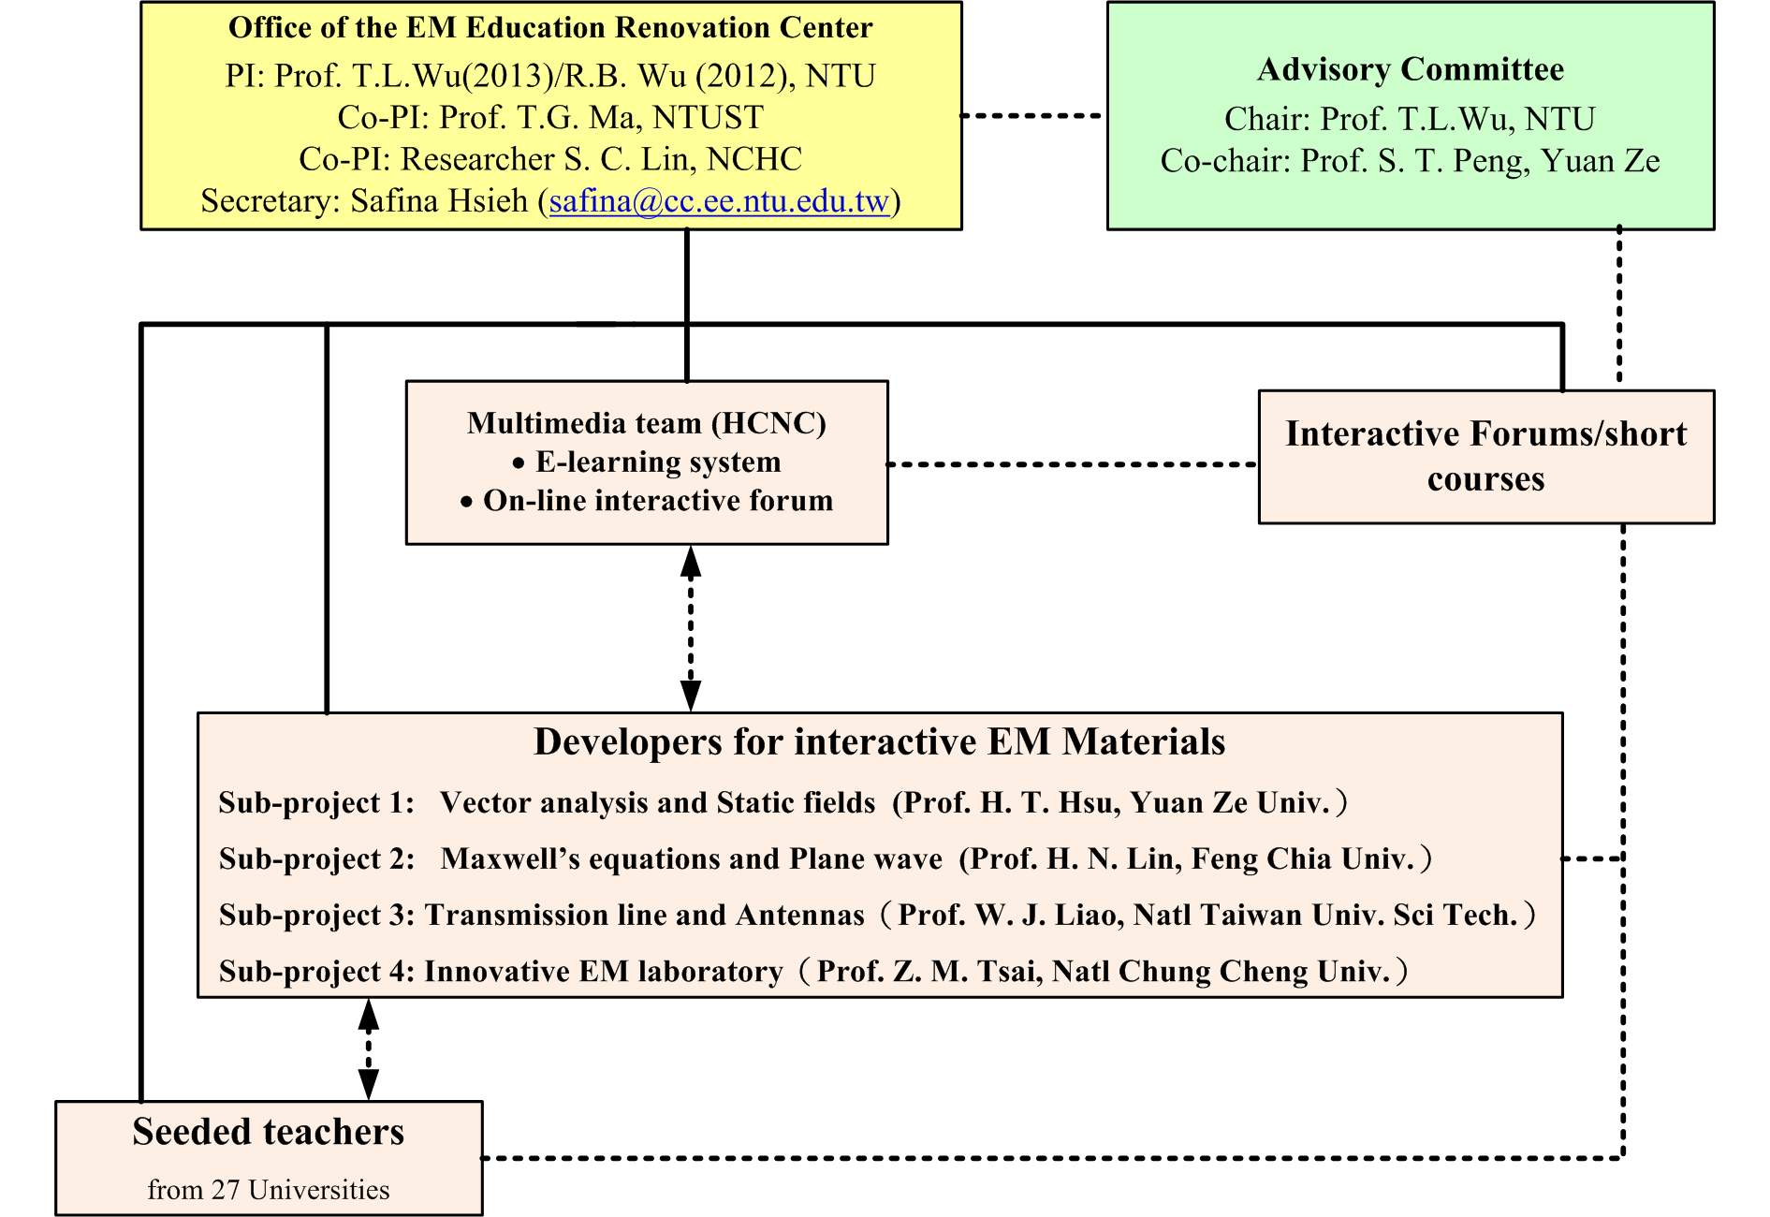
Organization
YZU

Slide 7
Budget
Two-year grant sponsored by the Ministry of Education, Taiwan.
Courseware development: NTD 16,000,000.
Promotion Program: NTD 27,000,000 (27 universities in Taiwan to evaluate the developed materials through trial teaching.)
Provide feedback from the students
to evaluate and enhance the quiz bank.

Slide 8
The Platform base on the Main Principle
SIMPLICITY
ACCESSIBILITY
Cyber-Learning Platform for EM Education
VISUALIZATION
EDUTAINMENT
Notes:
Continuation of the save concept by Dr.Peng.
simplicity - Unified Theory of Electromagnetics
Accessibility – Cyber-Learning Platform
visualize - Web-based Interactive Learning Assistant
Edutainment - Lego Application to EM Lab

Slide 9
Simplicity
Redraw the roadmap for fundamental EM education in Taiwan.
Comply with the goal of simplifying and condensing the contents.
Not to reproduce what in existent textbooks, but to develop innovative teaching thoughts and approaches.

Slide 10
Accessibility
Providing seamless accessibility regardless of the platforms.
Taking advantage of modern mobile devices and high speed data links.
Establishing tight connection with National Center for High-performance Computing (NCHC), Taiwan.

Slide 11
Visualization
A number of EM Animations to elaborate the physical phenomena in EM fields/waves.
Have received excellent feedbacks.
Video chips for self-learning
Semi-open course ware.
15-20 mins per chip.
Customized self-learning paths.
Adaptive learning curve.

Slide 12
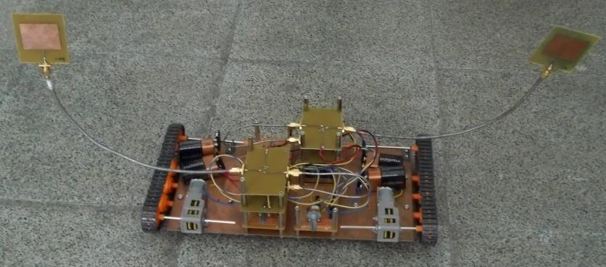
Edutainment
Have fun with Creative “LEGO” Experiments.
to stimulate students’ curiosity and interest toward EM theory.
Have fun with EM Animations.
It does work!
Have fun with the Video Chips and
“Enjoy” a quiz bank with more than 2200
problems collected from experts in Taiwan.

Slide 13
Cyber-Learning Platform for EM Education
SAVE
S: provide simplicity and understandability multimedia course material
A: learning accessibility via internet
V: provide visualization EM math equation animation and simulation to help students understand EM math equations
E: learning through edutainment with multimedia course material, EM math equation animation and test bank
SIMPLICITY
ACCESSIBILITY
e-Learning Platform for EM Education
VISUALIZATION
EDUTAINMENT
Notes:
SAVE的各項解說：
simplicity ：multimedia course material
accessibility ：via internet
visualize ：EM math equation animation
edutainment ：multimedia course material, EM math equation animation and test bank

Slide 14
Simplicity Accessibility Visualization Edutainment

Slide 15
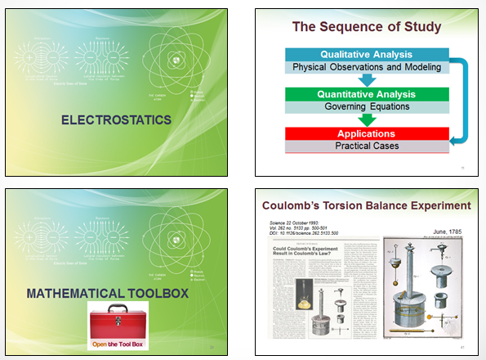
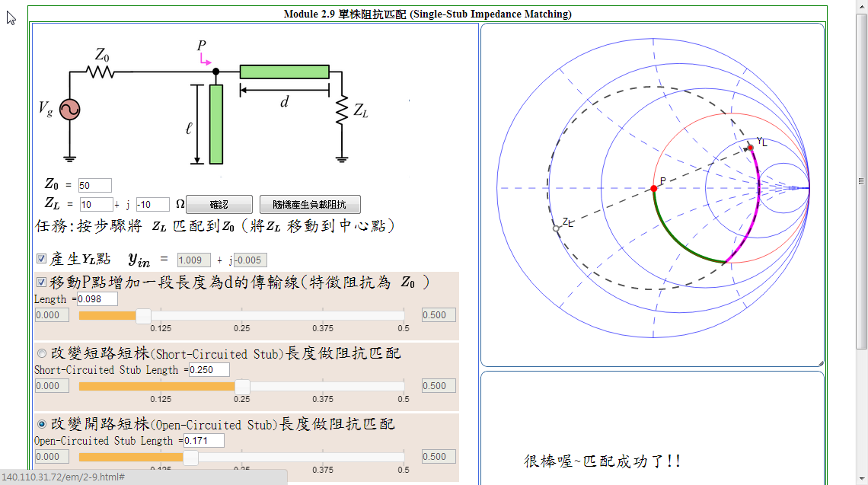
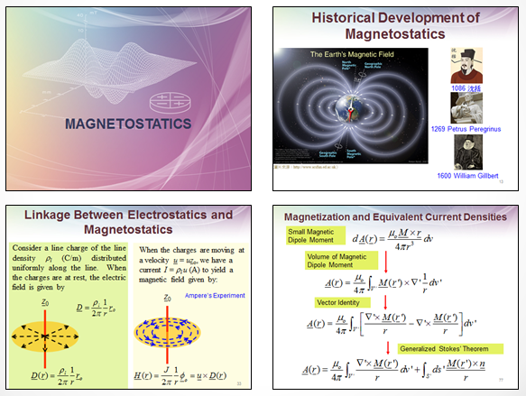
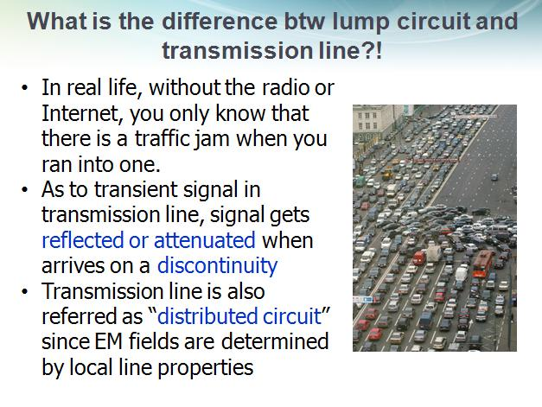
Some samples of the slides

Slide 16
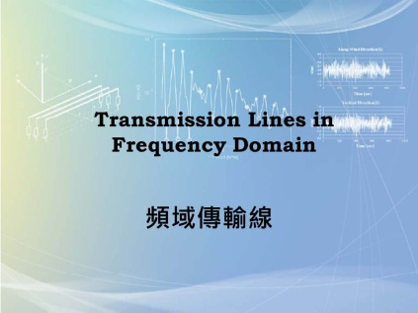
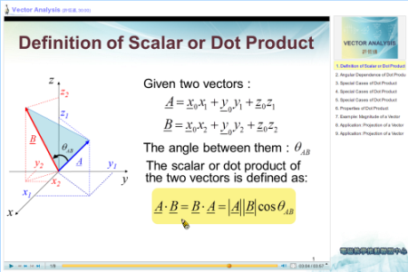
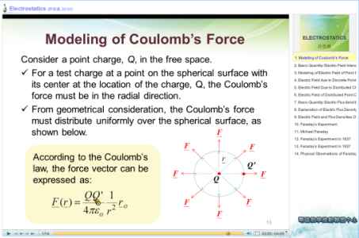
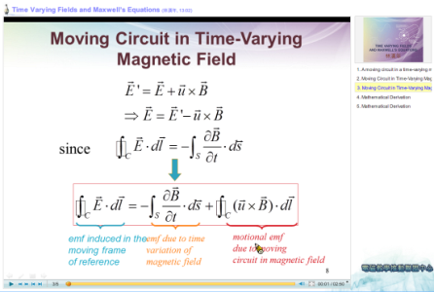
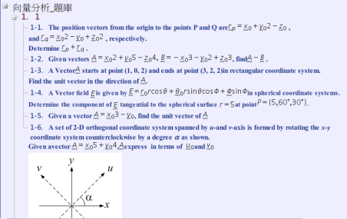
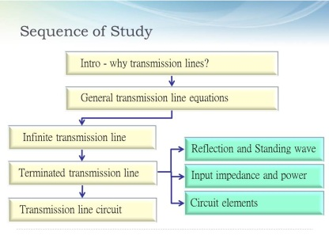
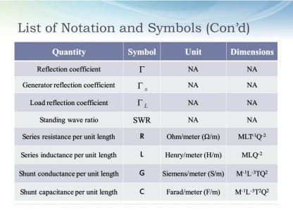


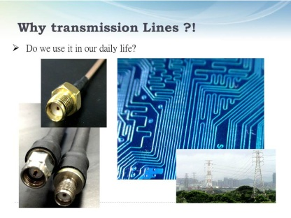
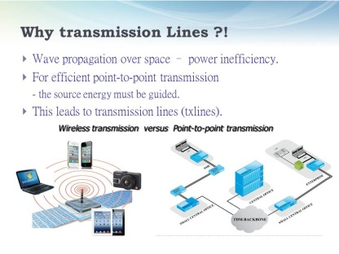
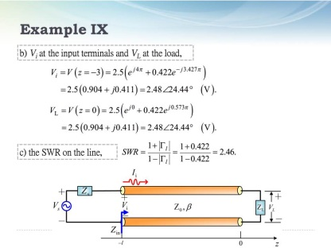
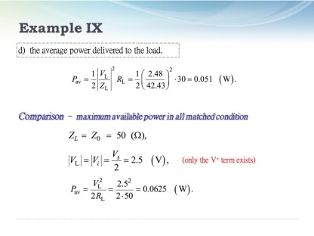
Teaching Material Simplicity
Transform each short teaching materials into multimedia materials.
produce tests
Divide the full teaching material (ppt) into several short teaching materials.
Notes:
Divide each full teaching material (ppt) into several short teaching materials
produce each short teaching materials to multimedia materials
produce tests 完整投影片教材—分成好幾個簡短的教材—製作多媒體教材—完成課程內容—增加測驗

Slide 17
Content Management System
Contents and Interactive Animations
Test Bank
Content Management System

Slide 18
Simplicity Accessibility Visualization Edutainment

Slide 19
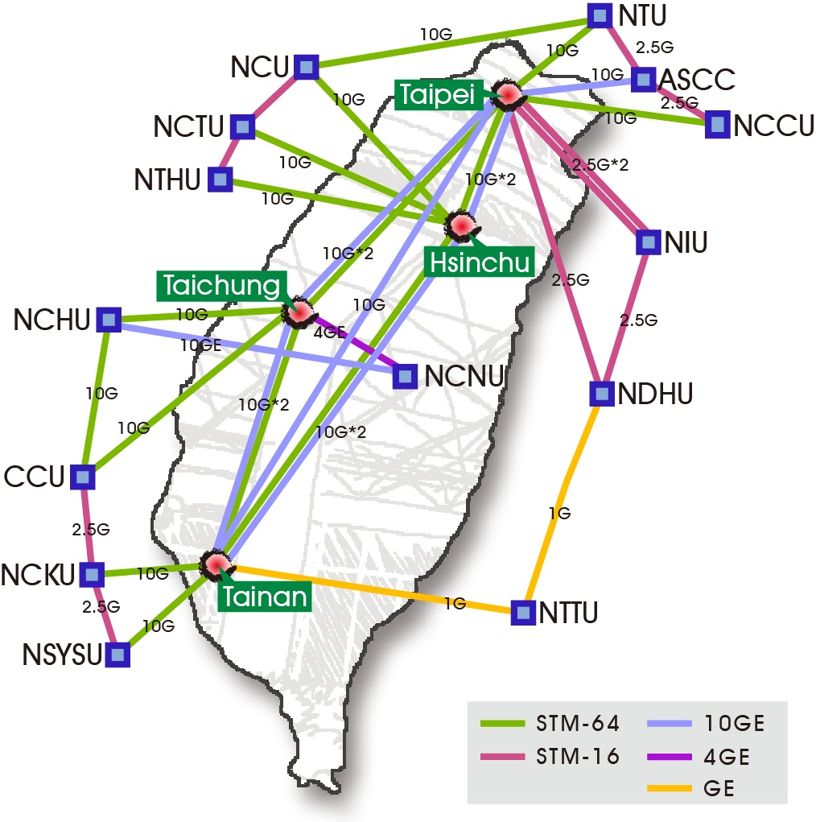
TWAREN Backbone Map
four core nodes
The Taipei Node: Taipei Technology Building
The Hisnchu Node: Hsinchu Headquarter, NCHC
The Tainan Node: Southern Business Unit, NCHC
The Taichung Node: Central Business Unit, NCHC
12 regional network centers (a.k.a. GigaPOPs.)
1 access node
Notes:
Accesslibity: learning accessibility via internet NCHC has a high-speed network and storage devices
Through twaren, we have the capability to provide high-quality online learning platform

Slide 20



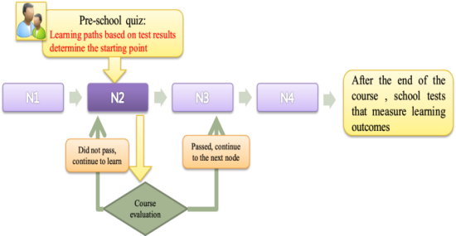



Cyber-Learning Platform for EM Education
e-learning Platform
LCMS : manage teaching materials
LPMS : manage learning paths
LMS : manage class and students
Cyber-Learning Platform
Notes:
The e-learning platform provide three system
CMS: manage teaching materials
LPMS: manage learning paths
LMS: manage class and students

Slide 21
Simplicity Accessibility Visualization Edutainment

Slide 22


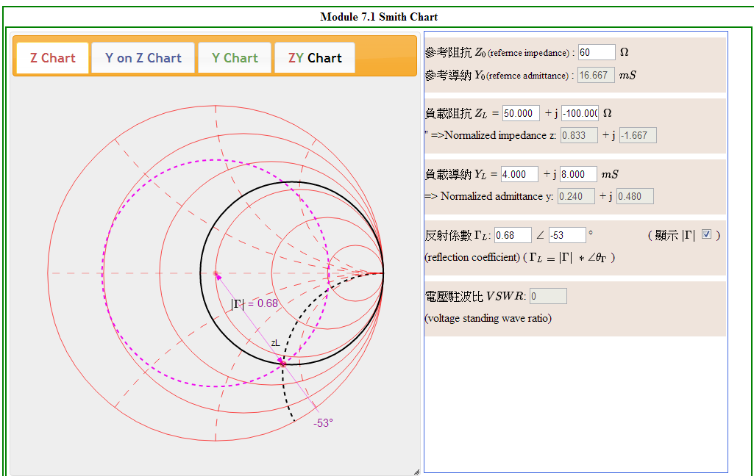

EM Math Equation Animation
Notes:
We put the complex EM Math Equation for visualization
Students in learning can be more easily understood the EM Math Equation

Slide 23

EM Math Equation Animation
HTML5
JavaScript
CSS

Slide 24
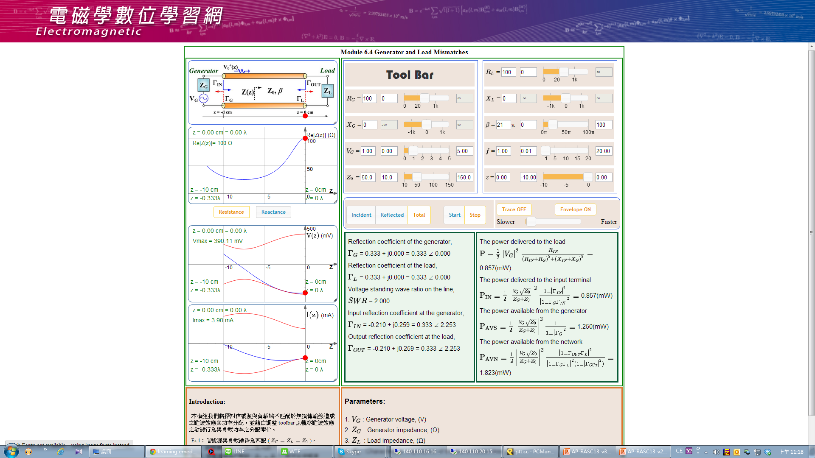
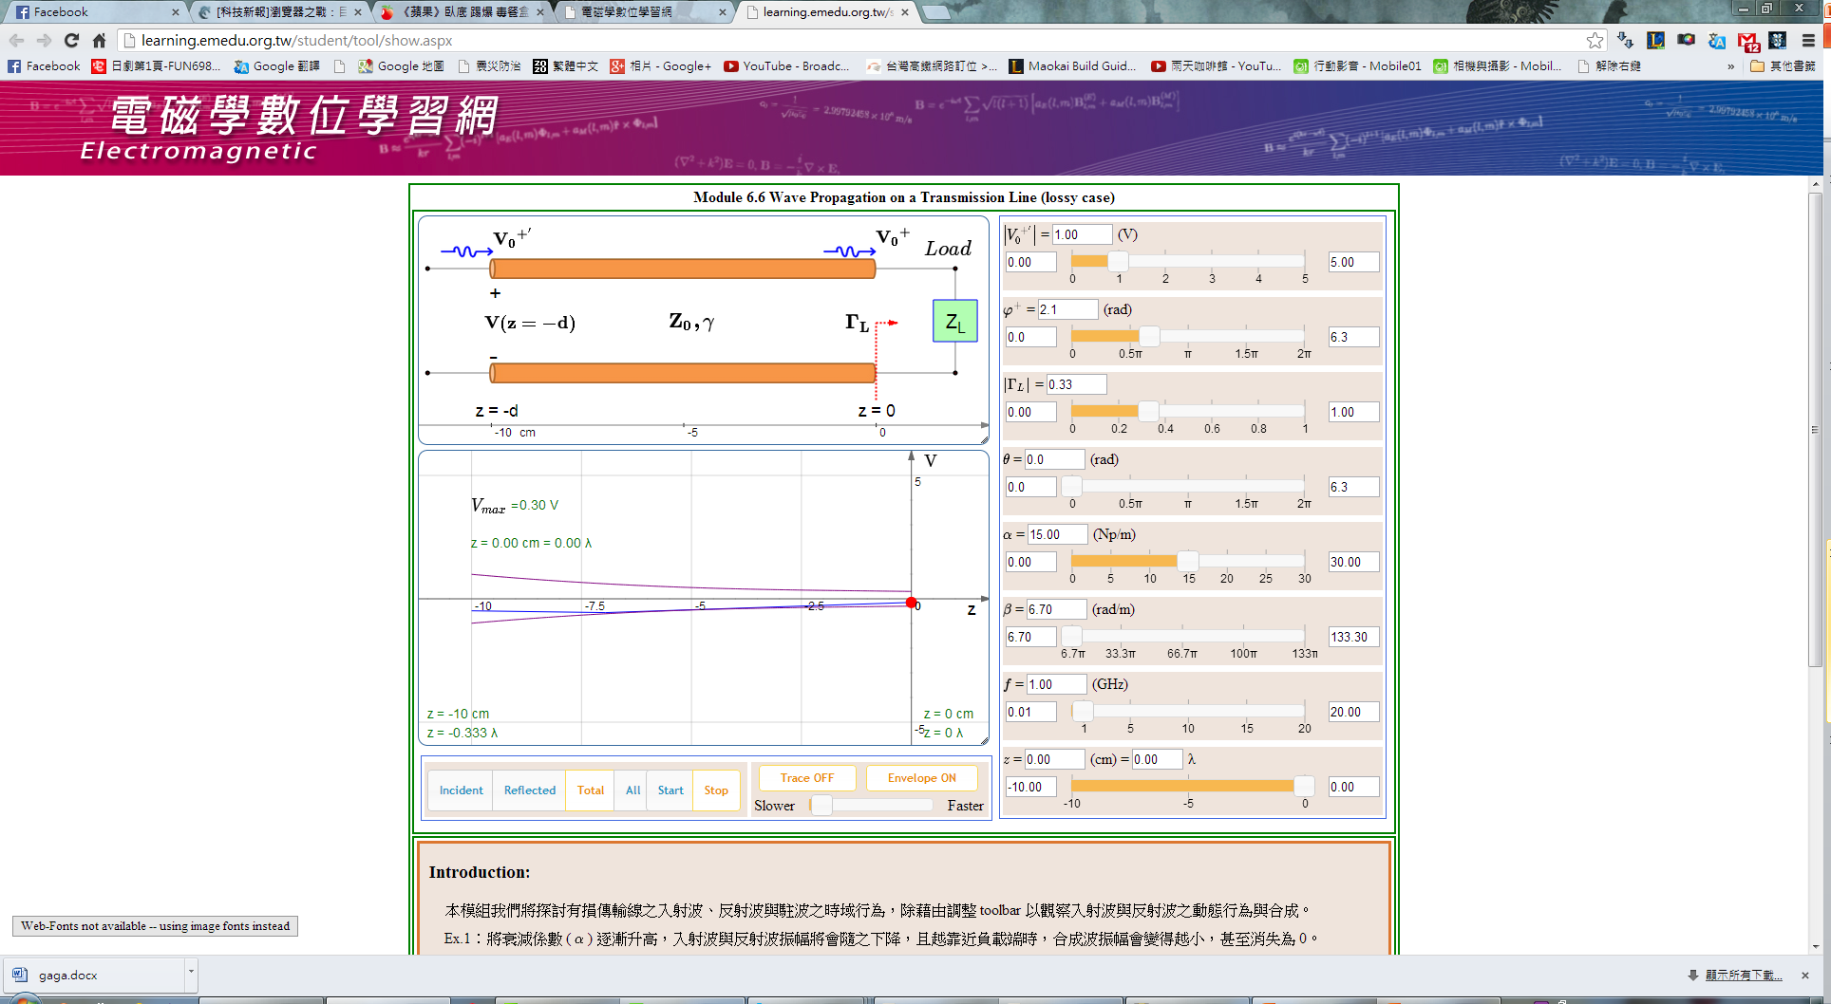
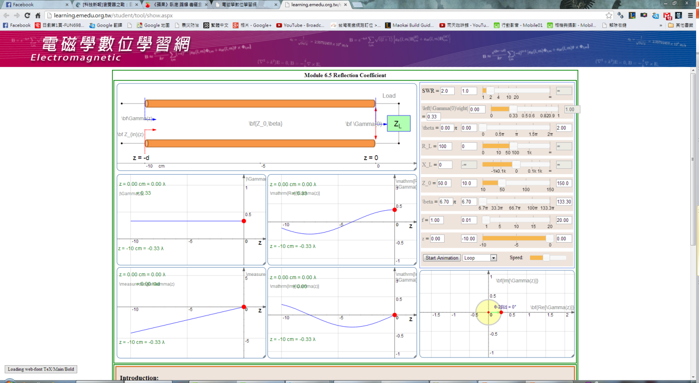
EM Math Equation Animation
Wave Propagation on a Transmission Line(lossless case)
Generator and Load Mismatches
Reflection Coefficient
Smith Chart
Notes:
The sample of the EM Math Equation Animation

Slide 25
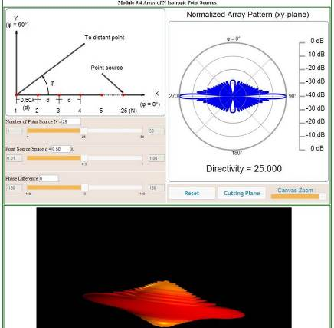
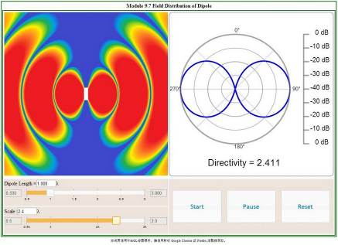
EM Math Equation Animation
New EM math equation animation will use WebGL to develop
Notes:
New EM math equation animation will use WebGL to develop
Provide more type and style of the EM math equation

Slide 26
EM Math Equation Animation
Ch5. Time Domain Transmission Line
5.1 Bouncing Signal in T. Line w/ DC Source
5.2 Bouncing Signal in T. Line w/ Impulse Source
5.3 Bouncing Signals in 3 Sec. T.-Line w/ Pulse Source
5.4 Bouncing Signal in a T.-Line System w Shunt/Series Discontinuity
Ch6. Transmission Lines
6.1 Wave Propagation on a Transmission Line(lossless case)
6.2 Standing Wave Pattern(lossless case)
6.3 Input Impedance
6.4 Generator and Load Mismatches
6.5 Reflection Coefficient
6.6 Wave Propagation on a Transmission Line (lossy case)
6.7 Standing Wave Pattern (lossy case)

Slide 27
EM Math Equation Animation
Ch7. Smith Chart
7.1 Smith Chart
7.2 Smith Chart and Transmission Lines
7.3 Quarter-wavelength Transformer
7.4 Single-Stub Impedance Matching
7.5 Double-Stub Impedance Matching (八分之一波長)
7.6 Double-Stub Impedance Matching (十六分之一波長)
Ch9. Antennas
9.1 Linear Polarization
9.2 Circular Polarization
9.3 Elliptical Polarization

Slide 28
Simplicity Accessibility Visualization Edutainment

Slide 29
Dynamic Learning Path Management
C1
C1
C2
C3
C1U1
C1U2
C2U1
C3U2
C1U1
C1U2
C2U1
C2U2
C3U1
C3U2
C1U1S1
C1U1S2
C2U1S1
C2U1S2
C1U1S1
C1U1S2
C1U2S1
C2U1S1
C2U1S2
C3U1S1
C3U1S2
C3U2S1
C1U2S1
C2U2S1
C3U1S1
C3U2S1
CMS
N1
N2
N3
N4
C1
TEST
C2U1
TEST
C3U1S1
TEST
C3U2
TEST
LPMS
Notes:
學習路徑lpms的概念 Through the content in the CMS
Users can combined the CMS content into a learning path to design their own LPMS.

Slide 30
Dynamic Learning Path
Pre-school quiz:
Learning paths based on test results determine the starting point
After the end of the course , school tests that measure learning outcomes.
N1
N2
N3
N4
Did not pass, continue to learn
Passed, continue to the next node
Course evaluation
Notes:
he Dynamic Learning Path is to allow students to go through post-test to determine whether to proceed to the next lesson
If pass n2->n3
Else Continuous Learning n2

Slide 31
Conclusion & Future Work

Slide 32
Conclusion
Cyber-learning Platform
LCMS, LMPS, LMS, …
Content
Test Bank (3,835 tests)
Learning Path (207 paths)
9 courses (60 hours)
29 math equation animations
Activity
28 university/college, 125 classes, 169 teachers, 3,894 students, 230 lectures
Notes:
第一年的執行成果

Slide 33
Future Work
Increase the Content
Test bank
Animation
Course set
Provide the learning platform on mobile devices(android, iOS)
Create the Simulation-base Learning System
Notes:
Future Work

Slide 34
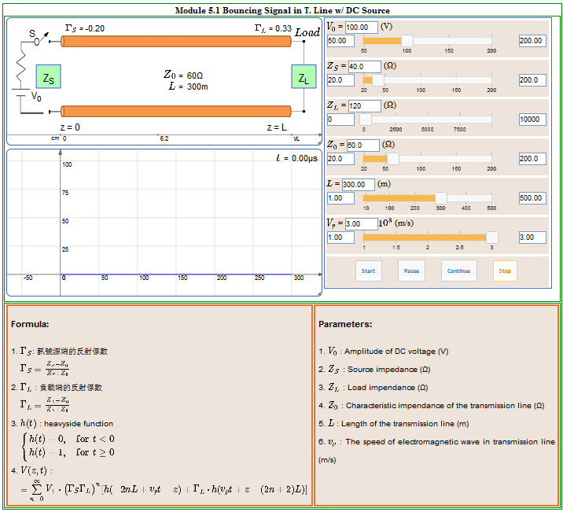
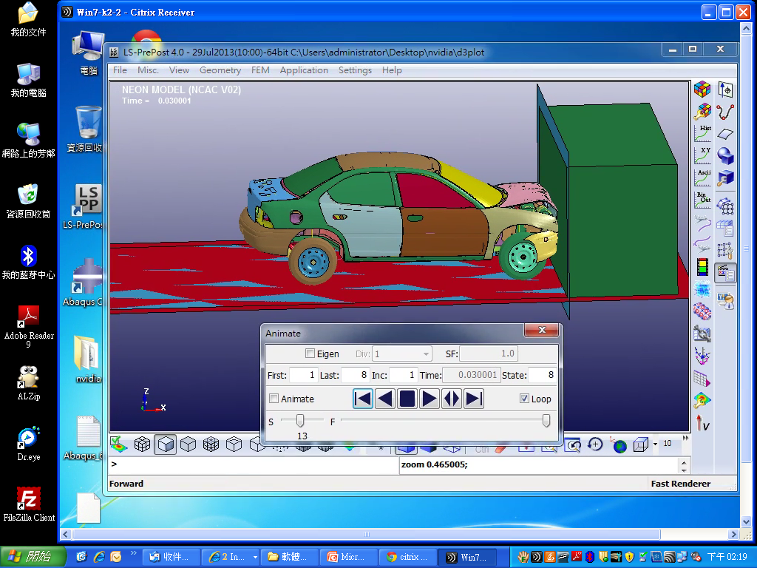
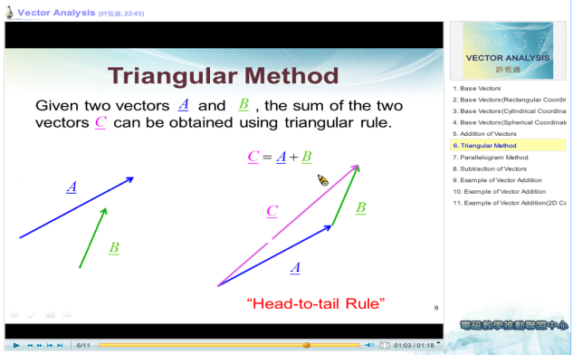
Future Work
Multimedia-base learning
(GUI run on local)
Simulation-base learning
(GUI run on remote)
Digital material
Powerpoint，video/audio
Notes:
Future Work

Slide 35
Future Work
Numerical simulation
CAD
Preprocessor
Solver
Postprocessor
Optimization
Notes:
Future Work

Slide 36
Future Work
Tools(commercial, open source, owned , others)
Courses
FreeCAD,
Open CASCADE
CAD
Pre-processing
ANSYS ICEM CFD
Salome, Gmsh
Preprocessor
Finite element method
Structural mechanics
ANSYS, LS-DYNA, CFX
Code_Aster, FastCap
PETSc
Solver
Fluid dynamics
ANSYS, LS-PrePost
Salome, ParaView
Postprocessor
Crashworthiness Analysis
LS-OPT
Optimization
Design optimization
Notes:
Future Work

Slide 37

Q ＆ A

Slide 38
TEACHING MATERIAL QUANTITIES DEVELOPED IN COURSE MODULES OF THREE WORKGROUPS.
Course Modules |  | Developed Teaching Materials
 |  | Module Details | Workgroup Summary
Workgroup #1 | Vector Analysis | 206 slides, 202 problems, 10 hrs video clips, 2 interactive labs | 587 slides, 632 problems, 26 hrs video clips, 4 interactive labs
 | Static Electrics | 213 slides, 212 problems, 8 hrs video clips, 1 interactive labs
 | Static Magnetics | 168 slides, 216 problems, 8 hrs video clips, 1 interactive labs
Workgroup #2 | Maxwell Equations | 81 slides, 171 problems, 11 hrs video clips, 1 interactive labs | 394 slides, 446 problems, 22.5 hrs video clips, 5 interactive labs
 | Waveguides | 175 slides, 64 problems, 2.5 hrs video clips, 2 interactive labs
 | Uniform Plane Wave | 138 slides, 211 problems, 12 hrs video clips, 2 interactive labs
Workgroup #3 | Transmission Line in Freq. Domain | 82 slides, 285 problems, 7.5 hrs video clips, 7 interactive labs | 353 slides, 840 problems, 18.5 hrs video clips, 28 interactive labs
 | Smith Chart | 61 slides, 191 problems, 6 hrs video clips, 7 interactive labs
 | Transmission Line in Time Domain | 102 slides, 210 problems, 5 hrs video clips, 7 interactive labs
 | Antenna | 110 slides, 154 problems, 7 interactive labs
WG #4 | EM Laboratories | 360 slides, 160 pages lab manual, 39 problems, 4 sample lab designs

